Slide 1
Chapter 7:
Thinking & Intelligence

Slide 2
COGNITIVE PSYCHOLOGY
Cognition == thinking
It encompasses the processes associated with:
Perception
Knowledge
Problem-solving
Judgement
Language
Memory

Slide 3
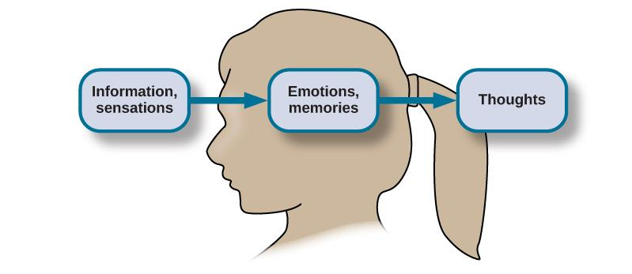
COGNITION
Sensations and information are received by our brains, filtered through emotions and memories, and processed to become thoughts.

Slide 4
CONCEPTS & PROTOTYPES (1)
How does the brain organize information?
Concepts – categories of linguistic information, images, ideas, or memories.
Used to see relationships among different elements of experience.
Can be complex and abstract (e.g. the idea of justice) or concrete (types of birds).
Prototype – the best example or representation of a concept.
E.g. Mahatma Gandhi could be a prototype for the category of civil disobedience.
Figure 7.3

Slide 5
CONCEPTS & PROTOTYPES (2)
Category memberships are fuzzy
No clear boundaries
Boundary conditions: How do we define category members?
Notes:
Satisfies Learning Objective 2: Demonstrate an understanding of concepts, categories, and theories of their representation.
Fuzzy boundaries: Categories, despite their apparent concreteness, have fuzzy boundaries.
Boundary conditions: These are important in defining categories.
Researchers think of categories as complex and related to each other in multiple ways because of these boundary conditions.
Levels of categorization: Categories are nested structures in which the level of organization is important in defining the category.
There are three such levels: Basic, subordinate, and superordinate:
The basic level is the one we are most likely to invoke.
The subordinate level allows for more specific or specialized categories to be formed.
Superordinate categories are higher order categories that include general information and many more common categories.
These levels are fluid.
Basic-level information is retrieved faster than subordinate or superordinate information.
Different levels are associated with different areas of the brain, as examined and demonstrated by Kosslyn et al. who used positron emission tomography (PET) technology to examine categorization.

Slide 6
Defining Concepts
How would you define…
Birds
Notes:
Take a sheet of paper. Draw a bird!

Slide 7
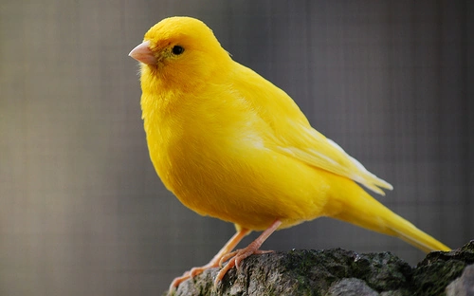
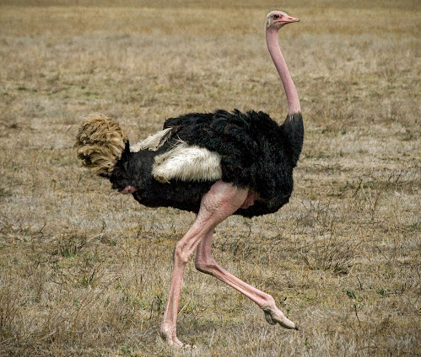
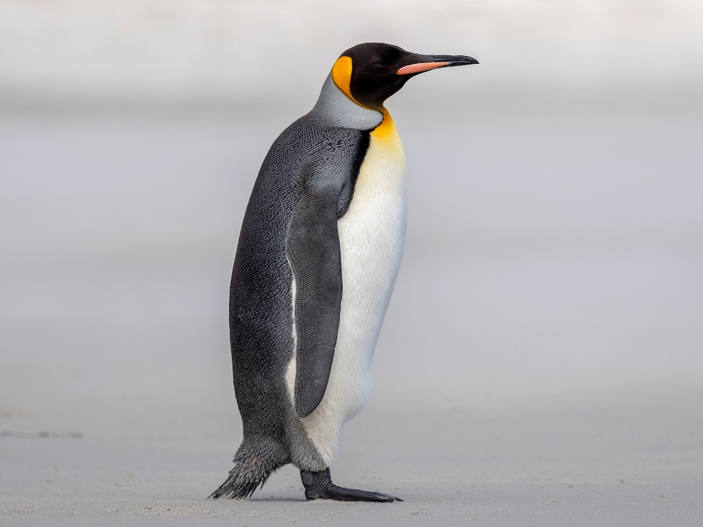
Birds…
Notes:
Satisfies Learning Objective 2: Demonstrate an understanding of concepts, categories, and theories of their representation.
Fuzzy boundaries: Categories, despite their apparent concreteness, have fuzzy boundaries.
Boundary conditions: These are important in defining categories.
Researchers think of categories as complex and related to each other in multiple ways because of these boundary conditions.
Levels of categorization: Categories are nested structures in which the level of organization is important in defining the category.
There are three such levels: Basic, subordinate, and superordinate:
The basic level is the one we are most likely to invoke.
The subordinate level allows for more specific or specialized categories to be formed.
Superordinate categories are higher order categories that include general information and many more common categories.
These levels are fluid.
Basic-level information is retrieved faster than subordinate or superordinate information.
Different levels are associated with different areas of the brain, as examined and demonstrated by Kosslyn et al. who used positron emission tomography (PET) technology to examine categorization.

Slide 8
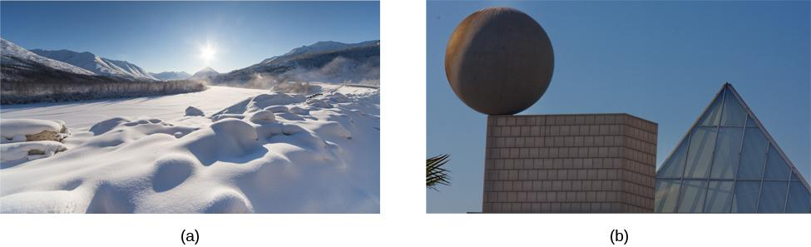
NATURAL & ARTIFICIAL CONCEPTS
Natural concepts:
Created “naturally” through either direct or indirect experience.
E.g. our concept of snow.
Artificial concepts:
Defined by a specific set of characteristics.
E.g. Properties of geometric shapes (squares, triangles ,etc).
Figure 7.4 (credit a: modification of work by Maarten Takens; credit b: modification of work by “Shayan (USA)”/Flickr)

Slide 9
Concepts and Categories (1)
Animals
Superordinate
Birds
Basic
Specific Types of Birds
Subordinate
Notes:
Satisfies Learning Objective 2: Demonstrate an understanding of concepts, categories, and theories of their representation.
Fuzzy boundaries: Categories, despite their apparent concreteness, have fuzzy boundaries.
Boundary conditions: These are important in defining categories.
Researchers think of categories as complex and related to each other in multiple ways because of these boundary conditions.
Levels of categorization: Categories are nested structures in which the level of organization is important in defining the category.
There are three such levels: Basic, subordinate, and superordinate:
The basic level is the one we are most likely to invoke.
The subordinate level allows for more specific or specialized categories to be formed.
Superordinate categories are higher order categories that include general information and many more common categories.
These levels are fluid.
Basic-level information is retrieved faster than subordinate or superordinate information.
Different levels are associated with different areas of the brain, as examined and demonstrated by Kosslyn et al. who used positron emission tomography (PET) technology to examine categorization.

Slide 10
Concepts and Categories (2)
Exemplar Theory: Categories have large numbers of specific instances
Example: Each time you encounter a specific type of bird you have to remember all details of it
Potential problem?
Notes:
Satisfies Learning Objective 2: Demonstrate an understanding of concepts, categories, and theories of their representation.
Exemplar theory: Categories are classified by maintaining a large number of specific instances of a category (exemplars) that are associated with each other in semantic memory.
It is distinct from prototype theory.
It accounts for the multidimensional nature of a category.
Priming can be specific to the particular aspect of the exemplar that is being primed.
Criticism of the theory centers on its premise that it necessitates a large memory system that can store large numbers of exemplars for different categories.
This criticism has been countered with the fact the seemingly limitless capacity of long-term memory to store information.
Feature comparison theory: We define our categories by maintaining a list of features for any particular category.
New objects are matched to the list of features and categorized accordingly.
Defining features: According to feature comparison theory, defining features are required for any example of a particular category.
Characteristic features: According to feature comparison theory, characteristic features generally accompany an instance of the category but are not required.
Criticism of feature comparison:
This is an essentially flawed theory because few categories have clear defining features.
As a result, the prototype theory is considered a better choice for explaining the structure of semantic memory.

Slide 11
SCHEMATA (1)
Schema – a mental construct consisting of a collection of related concepts.
When a schema is activated, we automatically make assumptions about the person/object/situation.
Role schema – makes assumptions about how individuals in certain roles will behave.
What assumptions come to mind about a librarian?

Slide 12
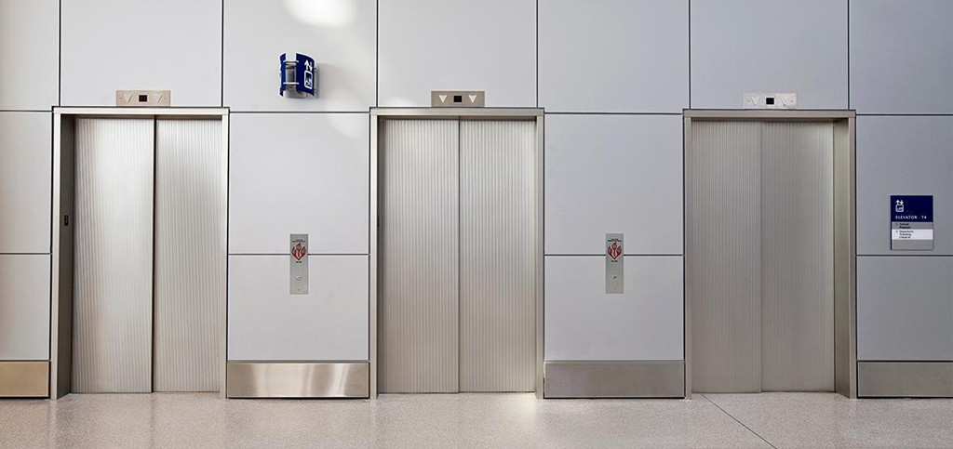
SCHEMATA (2)
Event schema (cognitive script) – a set of routine or automatic behaviors.
Can vary widely among different cultures and countries.
Dictate behavior.
Make habits difficult to break.
Notes:
E.g. when riding in an elevator, we automatically stand facing the door.

Slide 13

EVENT SCHEMA
Event schemas are difficult to change because they are automatic.
When we receive a text, our event schema is to pick up our phone and reply. The problem is that this automatic reaction will arise even in situations when it is not safe to reply.
Texting while driving is dangerous, but it is a difficult event schema for some people to resist.
Research suggests that just the event schema of regularly checking our phone makes it increasingly difficult to resist picking it up while driving.

Slide 14
LANGUAGE
Language – a communication system that involves using words and systematic rules to organize those words to transmit information from one individual to another.
Components of Language
Lexicon – the words of a given language.
Grammar – the set of rules that are used to convey meaning through the use of the lexicon.
Phoneme – a basic sound unit (ah, eh,).
Morphemes – the smallest units of language that convey some type of meaning.
Language is constructed through semantics and syntax.
Semantics – the meaning we derive from morphemes and words.
Syntax – the way words are organized into sentences.

Slide 15
LANGUAGE DEVELOPMENT
Noam Chomsky – proposed that the mechanisms underlying language acquisition are biologically determined.
Language develops in the absence of formal instruction.
Language acquisition follows similar patterns in children from different cultures/backgrounds.
Critical period – proficiency at acquiring language is maximal early in life.
Being deprived of language during the critical period is though to impede language acquisition
Testing this is difficult….

Slide 16
Case Study: Genie Wiley (1 of 4)
In 1970 was admitted to a children’s hospital in Los Angeles at the age of 13
Spent the majority of her life (from the age of 2 onwards) strapped to a potty chair and locked away in a closet
The only human contact she had was with her mother

Slide 17
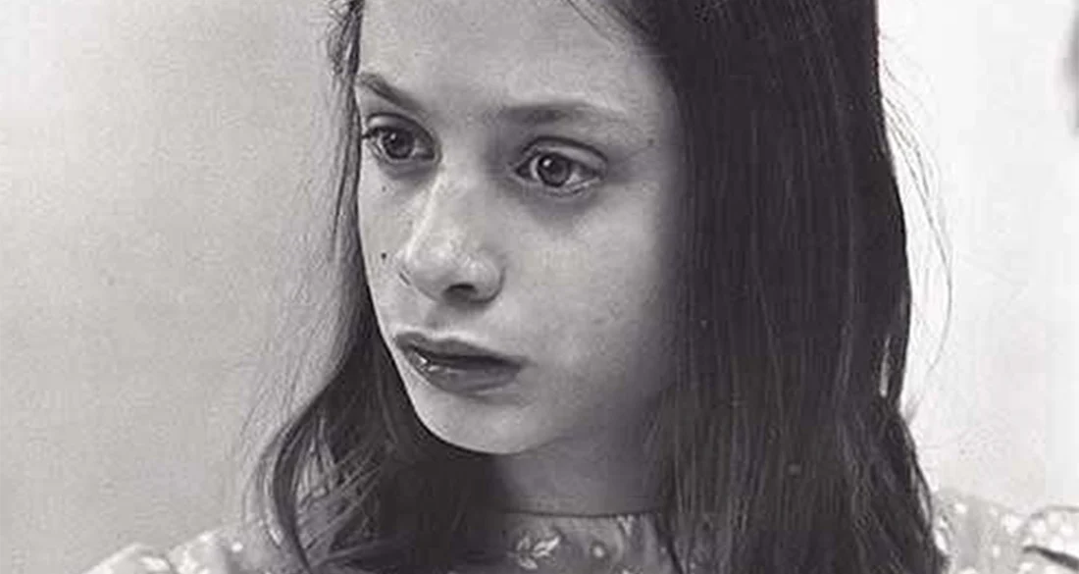
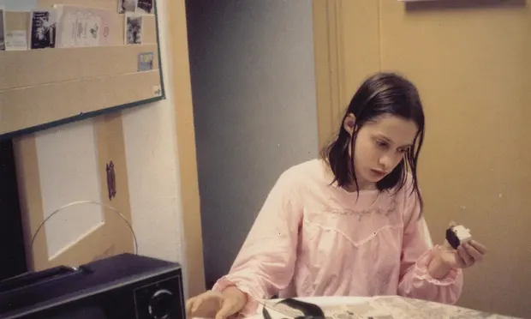
Case Study: Genie Wiley (2 of 4)
A few things to note:
  Mother was forbidden to spend more than a few minutes at a time with her
  No TV or Radio in the home
  No members of the family spoke to her
Genie grew up in a state of total physical, sensory, social, and emotional deprivation

Slide 18
Case Study: Genie Wiley (3 of 4)
Genie was not exposed to language during the critical period
Genie was eventually able to learn some language
  Struggled with morphology and syntax
  Struggled with grammar rules
Neurological tests showed no left-hemisphere language activity!

Slide 19
Case Study: Genie Wiley (4 of 4)
How was she able to use language?
  Plasticity!
  Right hemisphere attempted to compensate for the deficient language areas in the left hemisphere
As Genie began to acquire language, she went through some of the same stages normal children go through

Slide 20
PROBLEM SOLVING STRATEGIES (1)
Trial and error – continue trying different solutions until problem is solved.
Algorithm – step-by-step problem-solving formula.
Heuristic – general problem-solving framework.
Short-cuts.
A “rule of thumb”.
Working-backwards – begin solving the problem by focusing on the end result.
Breaking large tasks into a series of smaller steps.

Slide 21
PROBLEM SOLVING STRATEGIES (2)
When do people use heuristics?
When one is faced with too much information.
When the time to make a decision is limited.
When the decision to be made is unimportant.
When there is access to very little information to use in making the decision.
When an appropriate heuristic happens to come to mind in the same moment.

Slide 22
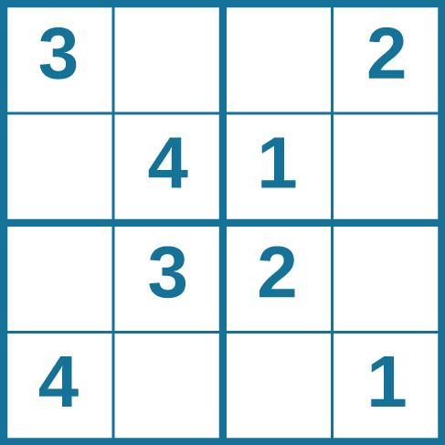
PUZZLE 1: SUDOKU

Slide 23
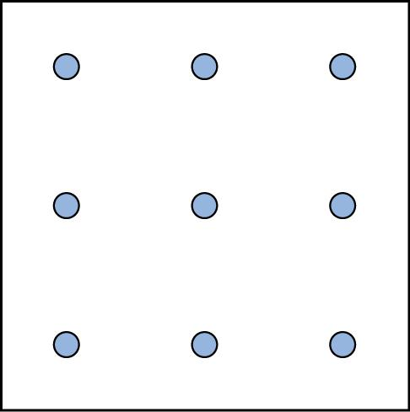
PUZZLE 2: SPATIAL REASONING
Connect all nine dots with four connecting straight lines without lifting your pencil from the paper.
Figure 7.9

Slide 24
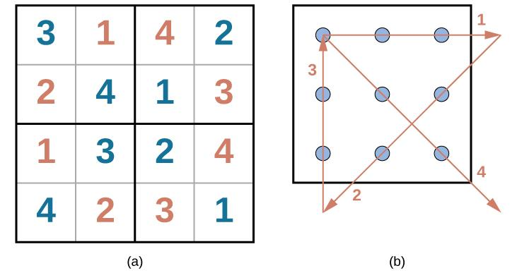
ANSWERS

Slide 25
Puzzle 3
Imagine you have a candle, thumbtacks and a box of matches. You need to mount the candle on the wall and light it. What do you do?
Functional fixedness – inability to perceive an object being used for something other than what it was designed for.
Imagine you have a candle, thumbtacks and a box of matches. You need to mount the candle on the wall and light it. What do you do?
Very few people think to use the box as a holder for the candle which can be tacked to the wall because they are fixated on its normal function.

Slide 26
PITFALLS TO PROBLEM SOLVING
“Insanity is doing the same thing over and over again and expecting a different result” – Albert Einstein.
Mental sets
Persistence in approaching a problem in a way that has worked in the past. (A set way of looking at a problem).
Becomes a problem when that way is no longer working.
(Credit: wikepedia)

Slide 27
BIASES (1)
Knowledge and reasoning are used to make decisions. However, sometimes our ability to reason can be swayed by biases.
Anchoring bias – tendency to focus on one piece of information when making a decision or solving a problem.
Confirmation bias – tendency to focus on information that confirms your existing beliefs.

Slide 28
BIASES (2)
Hindsight bias – leads you to believe that the event you just experienced was predictable, even though it wasn’t.
Representative bias – tendency to unintentionally stereotype someone or something.
Availability heuristic – tendency to make a decision based on an example, information, or recent experience that is readily available to you, even though it may not be the best example to inform your decision.

Slide 29
CLASSIFYING INTELLIGENCE
Psychologists have come up with many different ways to define intelligence.
Charles Spearman
Believed intelligence consisted of one general factor, called g.
Focused on commonalities amongst various intellectual abilities.
Raymond Cattell
Divided intelligence into two components.
Crystalized intelligence – acquired knowledge and the ability to retrieve it.
Knowing facts.
Fluid intelligence – the ability to see complex relationships and solve problems.
Knowing how to do something.
Notes:
What is intelligence?

Slide 30
Defining Intelligence
Intelligence: Ability to adapt to the world in which one lives.
Many different views!
  All views believe there are individual differences in people’s intellectual abilities that are consistent over time.
Notes:
LO 8-1: Describe intelligence, intelligence tests, and correlates of IQ.
I. Intelligence and Intelligence Tests
A. Intelligence: an individual’s ability to adapt to the world in which one lives
B. All views believe there are individual differences in people’s intellectual abilities
that are consistent over time

Slide 31
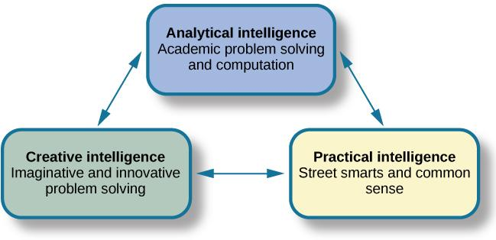
TRIARCHIC THEORY OF INTELLIGENCE
Robert Sternberg’s theory identifies three types of intelligence: practical, creative, and analytical.
Figure 7.12

Slide 32
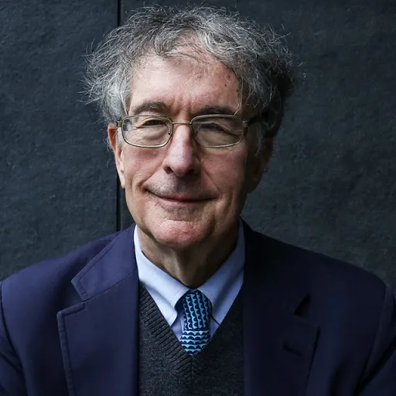
Multiple Intelligence Theory (1)
Howard Gardner
Multiple intelligence theory: eight independent kinds of intelligence.
Intelligence is biologically based and has own developmental pattern.
Notes:
D. Multiple Intelligences
a. Multiple intelligence theory: Gardner’s theory that proposes at least eight independent kinds of intelligence and expands the use of the term intelligence to refer to skills not usually considered intelligence by experts and has led to a great deal of debate among intelligence theorists and researchers
b. Each person and type of intelligence is biologically based and has its own unique developmental pattern

Slide 33
Multiple Intelligence Theory
Gardner rejects IQ score as a measure of human intelligence
Argues for eight intelligences:
  Linguistic intelligence
  Logical-mathematical intelligence
  Spatial intelligence
  Musical intelligence
  Bodily-kinesthetic intelligence
  Interpersonal /Intrapersonal intelligence
  Naturalist intelligence
  Existential intelligence

Slide 34
MEASURES OF INTELLIGENCE (1)
Measuring intelligence can come in many forms.
A person’s Intelligence quotient (IQ) is a score earned on a test designed to measure intelligence.
How do psychologists ensure that tests function as valid measures of intelligence?

Slide 35
MEASURES OF INTELLIGENCE (2)
The Stanford-Binet Intelligence Scale
Early 1900’s – Alfred Binet developed an intelligence test to use on children to determine which ones might have difficulty in school.
Louis Terman (a Stanford psychologist) modified Binet’s work by standardizing the administration of the test and testing thousands of children to establish a norm.
Standardization – the manner of administration, scoring, and interpretation of results is consistent.
Norming – giving a test to a large population so data can be collected comparing groups, such as age groups.
The resulting data provide norms/referential scores used to interpret future scores.
Standardization and norming ensure that new scores are reliable.

Slide 36
The Psychometric or Testing Approach (1)
Cattell-Horn-Carroll theory: Intelligence is a hierarchy
  Top general ability factor
  Broad dimensions of abilities: fluid intelligence, crystallized intelligence, memory capacity, and processing speed
    Factor analysis: statistical technique in which test items are correlated to identify groups of items that correlate highly with each other but not with other groups of items
  Bottom: Specific skills
Notes:
\

Slide 37
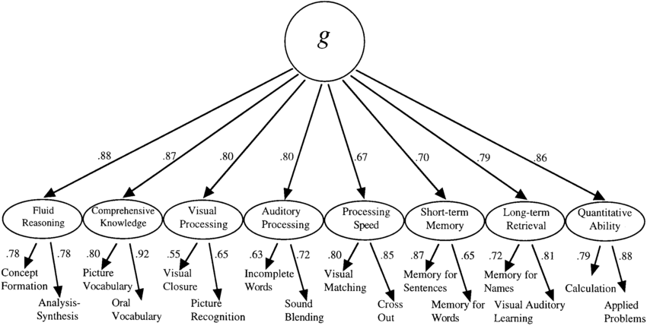
General Intelligence

Slide 38
The Psychometric or Testing Approach (2)
Stanford-Binet Test
  Mental age: child’s performance relative to same age children.
  Intelligence quotient (IQ): mental age (MA) divided by chronological age (CA), multiplied by 100.
  Stanford-Binet 5: today’s Stanford-Binet Intelligence Scales that measure intelligence as five abilities.
    Fluid
    Knowledge,
    Quantitative
    Visual-Spatial
    Working Memory
Notes:
Today’s test compares to norms, not mental age
1905: Alfred Binet and his student, Theodore Simon, published Binet-Simon test, which assessed children’s ability to reason verbally and numerically, solve problems, and think logically
b. Mental Age
i. Mental age: a child’s performance relative to same age children, as defined by Binet
ii. Most children’s mental age corresponds to their chronological age
iii. Children whose mental age is greater than their chronological age have a high level of intelligence
iv. Children whose mental age is less than their chronological age have a low level of intelligence
c. Intelligence Quotient
i. Intelligence quotient: a score defined as mental age (MA) divided by chronological age (CA), multiplied by 100 (IQ = MA/CA × 100)
ii. IQ score of 100 indicates average intelligence, regardless of a child’s age, because it shows the child can correctly answer the same items as same-age peers
d. Stanford-Binet 5
i. Stanford-Binet 5: today’s Stanford-Binet Intelligence Scales that measures intelligence as five intellectual abilities that are assessed with verbal and nonverbal tasks:
1. Knowledge
2. Quantitative reasoning
3. Visual-spatial processing
4. Working memory
5. Fluid reasoning
ii. No longer uses the concept of mental age
iii. IQ scores now reflect individuals’ performance compared with test norms (standards of performance based on average scores)

Slide 39
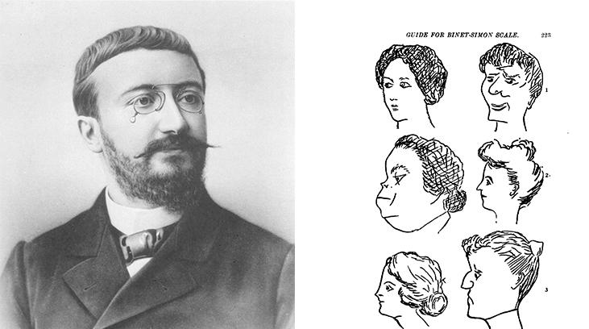
ALFRED BINET
French psychologist Alfred Binet helped to develop intelligence testing. (b) This page is from a 1908 version of the Binet-Simon Intelligence Scale. Children being tested were asked which face, of each pair, was prettier.

Slide 40
The Psychometric or Testing Approach (3)
Wechsler Adult Intelligence Scale (WAIS)
David Wechsler’s definition of intelligence - ”the global capacity of a person to act purposefully, to think rationally, and to deal effectively with his environment.”
In 1939, Wechsler developed a new IQ test by combining several subtests from other intelligence tests.
Tapped into a variety of verbal and nonverbal skills.
One of the most extensively used intelligence tests.
Wechsler Intelligence Scale for Children (WISC-V) is one of many versions used today that tests 1) verbal comprehension, 2) visual spatial, 3) fluid reasoning, 4) working memory and 5) processing Speed.

Slide 41
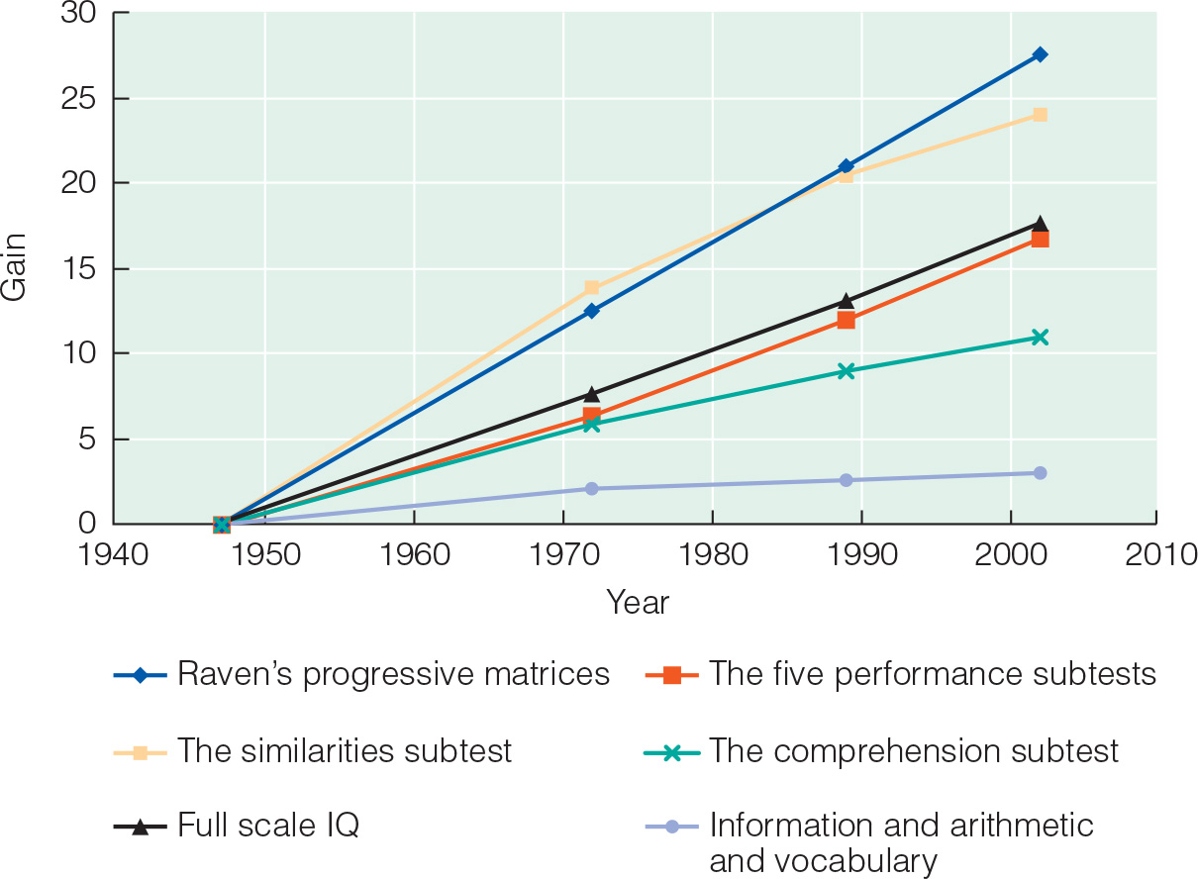
The Flynn Effect
After years of use within schools and communities, periodic recalibration of WAIS lead to an observation known as the Flynn effect.
The observation that each generation has a significantly higher IQ than the last.

Slide 42
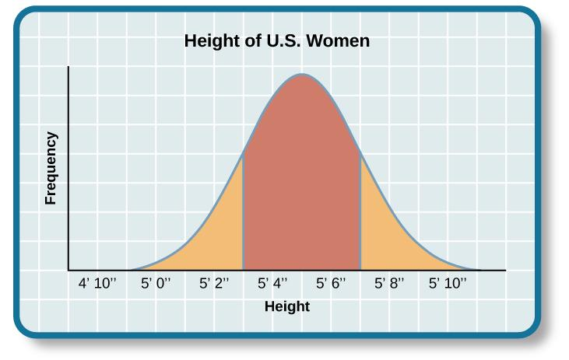
THE BELL CURVE
Results of intelligence tests follow the bell curve.
In psychological testing, this graph demonstrates a representative sample/normal distribution of a trait in the human population.
Representative sample – a subset of the population that accurately represents the general population.
Usually requires a large sample size.

Slide 43
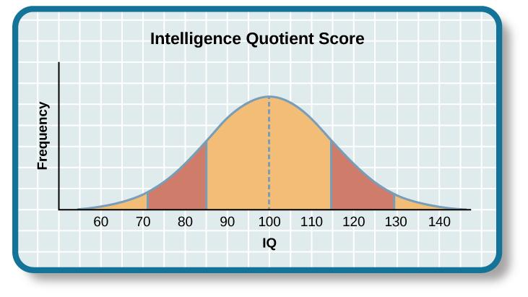
IQ BELL CURVE
The average IQ score is 100.
Standard deviations – describe how data are dispersed in a population.
One standard deviation in IQ testing is 15 points.
A score of 85 is one standard deviation below the mean (average).
Any score between one standard deviation above and below the mean is considered and average.
82% of the population have an IQ score between 85 and 115.

Slide 44
Extremes of Intelligence
Intellectual disability
  Have significantly below-average intellectual functioning (score of 70 or below on an IQ test)
Gifted
  Have an IQ score of 130 or higher or they show special abilities in areas valued by society

Slide 45
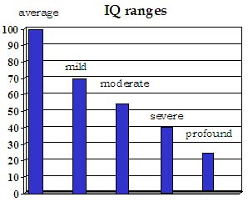
INTELLECTUAL DISABILITY
2.2% of the population has an IQ score below 70 and are considered intellectually disabled.
Exhibit deficits in intellectual functioning and adaptive behavior.
Formerly known as mental retardation.
The 4 subtypes are mild, moderate, severe and profound.
(Credit: National Institute of Health)

Slide 46
The Psychometric or Testing Approach (4)
Correlates of IQ
Academic achievement, educational attainment, occupational status, unemployment, income, and health and longevity.
Is IQ really measuring intelligence?
Notes:
LO 8-1: Describe intelligence, intelligence tests, and correlates of IQ.
D. Weschler Tests
a. Weschler tests—a set of widely used measures of intelligence constructed by David Wechsler, who viewed intelligence as “the global capacity of a person to act purposefully, to think rationally, and to deal effectively with his environment”
b. Children’s’ test = Wechsler Intelligence Scale for Children (WISC-V)
i. Composed of 10 subtests and 5 indexes: verbal comprehension, visual spatial, fluid reasoning, working memory, and processing speed
ii. Tests verbal and nonverbal abilities
iii. Score of 100 is average for a person’s age
iv. Standardized on samples of children that represent the total population of a country’s population
E. Correlates of IQ
a. Childhood academic achievement
b. Educational attainment
c. Occupational status
d Unemployment
e. Income
f. Health and longevity

Slide 47
IQ and School Achievement
Correlations between children’s and adolescents’ IQ scores and grades range from 0.50 to 0.86
  One of the best predictors of school achievement
  IQ scores do not predict college grades as well
    Motivation?

Slide 48
IQ and Occupational Success (1 of 2)
Professional and technical workers score higher on IQ tests than white-collar workers
Gap between those with higher intelligence and lower intelligence widened
Greater intelligence is required to handle more complex work

Slide 49
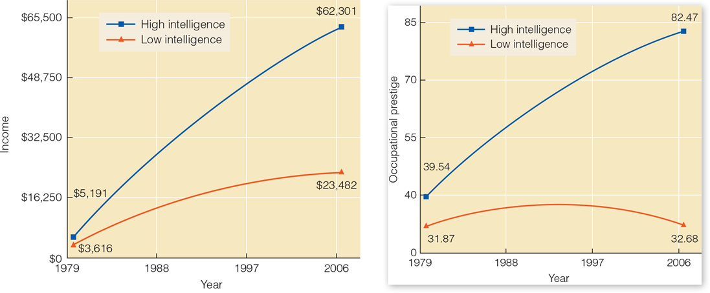
IQ and Occupational Success (2 of 2)
Notes:
Figure 9.6 The two graphs show income (left) and occupational prestige (right)

Slide 50
CREATIVITY
Creativity – the ability to generate, create, or discover new ideas, solutions, and possibilities.
Creative people usually:
Have intense knowledge about something.
Work on it for years.
Look at novel solutions.
Seek out the advice and help of other experts.
Take risks.
Creativity is often thought of as one’s ability to engage in divergent thinking.
Divergent thinking – thinking “outside the box”.
Used when more than one possibility exists on a situation.
Convergent thinking – ability to provide a correct or well-established answer or solution to a problem.

Slide 51
THE SOURCE OF INTELLIGENCE
Nature or Nurture?
Nature perspective – intelligence is inherited from a person’s parents.
The heritability of intelligence is often researched using twin studies.
Identical twins raised together and identical twins raised apart exhibit a higher correlation between IQ scores than siblings or fraternal twins raised together.
Nurture perspective – intelligence is shaped by a child’s developmental environment.
If parents present children with intellectual stimuli it will be reflected in the child’s intelligence level.
Most psychologists now believe levels of intelligence are a combination of both.
Notes:
Range of reaction
Theory that each person responds to the environment in a unique way based on his or her genetic makeup.
Genetic makeup is a fixed quantity.
Whether you reach your full intellectual potential is dependent upon environmental factors.

Slide 52
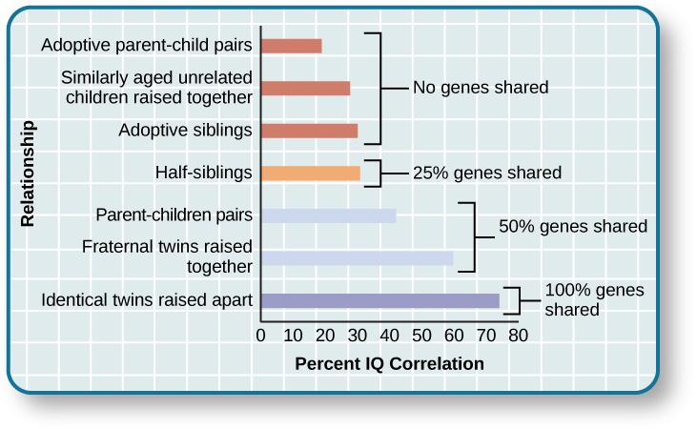
GENETICS AND IQ
Notes:
The correlations of IQs of unrelated versus related persons reared apart or together suggest a genetic component to intelligence.

Slide 53
Changes in IQ with Age (1 of 2)
IQ remains stable into older adulthood
Strongest predictor of intelligence in old age was intelligence at age 11
  Recently born cohorts outperform earlier cohorts
  Declines in intellectual abilities are not universal
Terminal drop
  Poor health
  Diseases
Unstimulating lifestyle
  Biggest declines elderly widows
    Low social status
    Engaged in few activities
    Dissatisfied with their lives

Slide 54
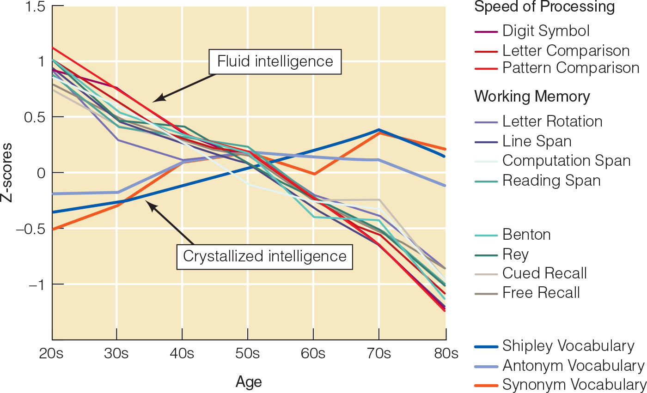

Slide 55
LEARNING DISABILITIES
Learning disabilities are cognitive disorders that affect different areas of cognition, particularly language or reading.
Specific neurological impairments, not an intellectual/developmental problem.
Often affect children with average to above-average intelligence.
Exhibit comorbidity with other disorders.
Dysgraphia
A learning disability resulting in a struggle to write legibly.
Have difficulty putting their thoughts down on paper.
Dyslexia
An inability to correctly process letters.
Most common learning disability in children.
May mix up letters within words and sentences (letter reversals).

